Slide 1

Welcome to Our Presentation

Slide 2
02
03
01
04
Business Case Study
Agenda
Solution Implementation Steps
Traffic Directions
Questions & Answers

Slide 3
01
02
03
04
Business Case Study
Agenda
Solution Implementation Steps
Traffic Directions
Questions & Answers

Slide 4

“ As a business with a web application currently running on our on-premises servers, we faced the challenge of migrating to the cloud to enhance scalability, security, and manageability.
Our goal is to seamlessly lift and shift our application to Azure, ensuring minimal disruption to our services and maintaining high performance.
We need a solution that provides robust network segmentation, secure connectivity, reliable application delivery, and comprehensive monitoring and backup. ”

Slide 5
09
05
10
06
After more investigation with Customer’s needs, we concluded the following requirements:
The customer wants regular backups and quick recovery of the VMs hosting his web app components to protect against data loss and ensure business continuity.
The customer wants a centralized cloud native security service to control and log all network traffic flowing between the VNets.
The customer requires a secure solution for his virtual machines to access a shared storage for storing application data without exposing it to the public internet.
Because of additional security appliances, the customer requires the implementation of a third-party firewall in the hub VNet to provide additional security measures and advanced threat protection for his infrastructure.
01
02
The customer requires a cloud design with centralized management and two workload environments: Production and Testing.
The customer needs a suitable workload hosting service for his web application with greater control and customization.
08
04
03
11
07
The customer needs comprehensive monitoring and logging capabilities to collect and analyze logs and metrics from all components of his web app environment for effective monitoring and troubleshooting.
The customer needs efficient connectivity between the VNets ensuring low latency and high bandwidth communication between the components.
The customer requires a regional, scalable load balancing option with applicable security rules to ensure secure and reliable delivery of his web application to end users.
The customer wants a secure way to connect his on-premises users to our Azure infrastructure, ensuring seamless and secure access to his web application and resources hosted in the cloud.
To facilitate management and maintenance, the customer needs a secure solution for RDP/SSH connectivity to the VMs hosting his web application components without exposing them to the public internet.

Slide 6
02
09
01
10
After more investigation with Customer’s needs, we concluded the following requirements:
The customer needs a suitable workload hosting service for his web application with greater control and customization.
The customer wants regular backups and quick recovery of the VMs hosting his web app components to protect against data loss and ensure business continuity.
The customer requires a cloud design with centralized management and two workload environments: Production and Testing.
The customer requires a secure solution for his virtual machines to access a shared storage for storing application data without exposing it to the public internet.
05
06
The customer wants a centralized cloud native security service to control and log all network traffic flowing between the VNets.
Because of additional security appliances, the customer requires the implementation of a third-party firewall in the hub VNet to provide additional security measures and advanced threat protection for his infrastructure.
04
08
07
11
03
The customer needs efficient connectivity between the VNets ensuring low latency and high bandwidth communication between the components.
The customer needs comprehensive monitoring and logging capabilities to collect and analyze logs and metrics from all components of his web app environment for effective monitoring and troubleshooting.
The customer wants a secure way to connect his on-premises users to our Azure infrastructure, ensuring seamless and secure access to his web application and resources hosted in the cloud.
The customer requires a regional, scalable load balancing option with applicable security rules to ensure secure and reliable delivery of his web application to end users.
To facilitate management and maintenance, the customer needs a secure solution for RDP/SSH connectivity to the VMs hosting his web application components without exposing them to the public internet.

Slide 7
02
06
05
01
After more investigation with Customer’s needs, we concluded the following requirements:
The customer needs a suitable workload hosting service for his web application with greater control and customization.
Because of additional security appliances, the customer requires the implementation of a third-party firewall in the hub VNet to provide additional security measures and advanced threat protection for his infrastructure.
The customer wants a centralized cloud native security service to control and log all network traffic flowing between the VNets.
The customer requires a cloud design with centralized management and two workload environments: Production and Testing.
09
10
The customer wants regular backups and quick recovery of the VMs hosting his web app components to protect against data loss and ensure business continuity.
The customer requires a secure solution for his virtual machines to access a shared storage for storing application data without exposing it to the public internet.
04
11
03
The customer needs efficient connectivity between the VNets ensuring low latency and high bandwidth communication between the components.
The customer wants a secure way to connect his on-premises users to our Azure infrastructure, ensuring seamless and secure access to his web application and resources hosted in the cloud.
The customer requires a regional, scalable load balancing option with applicable security rules to ensure secure and reliable delivery of his web application to end users.
08
The customer needs comprehensive monitoring and logging capabilities to collect and analyze logs and metrics from all components of his web app environment for effective monitoring and troubleshooting.
07
To facilitate management and maintenance, the customer needs a secure solution for RDP/SSH connectivity to the VMs hosting his web application components without exposing them to the public internet.

Slide 8

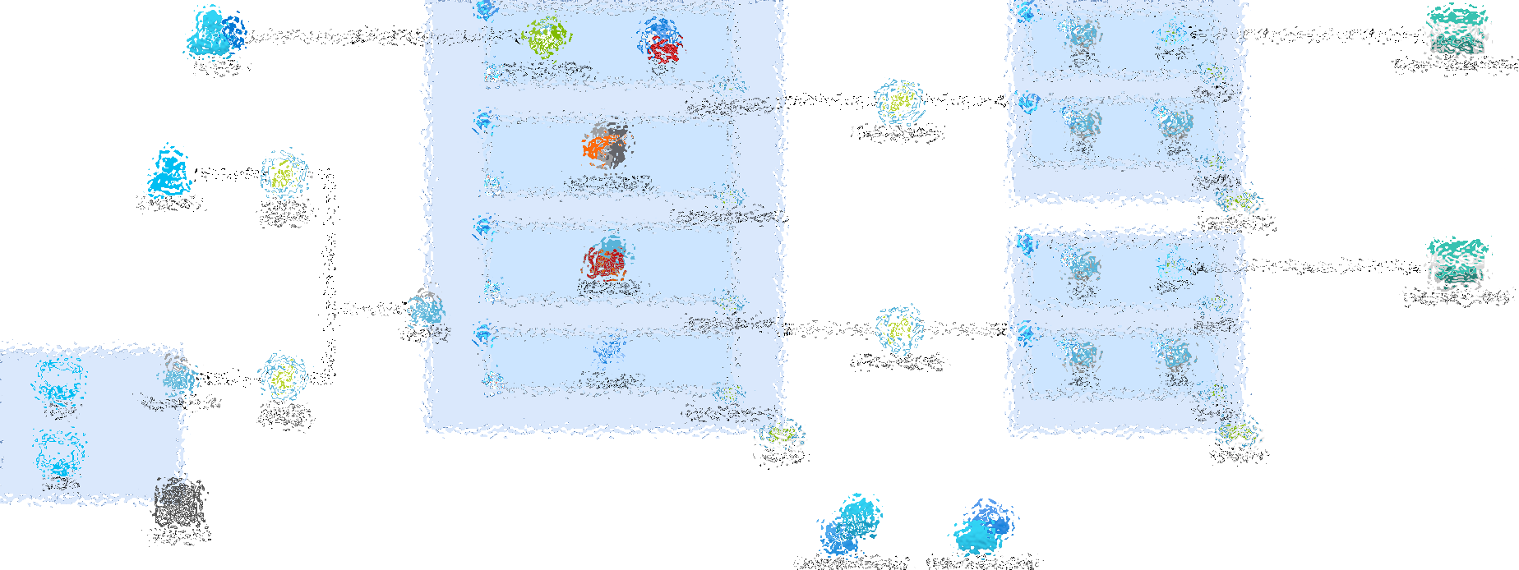
The Final Architecture

Slide 9

Let’s take it step by step

Slide 10
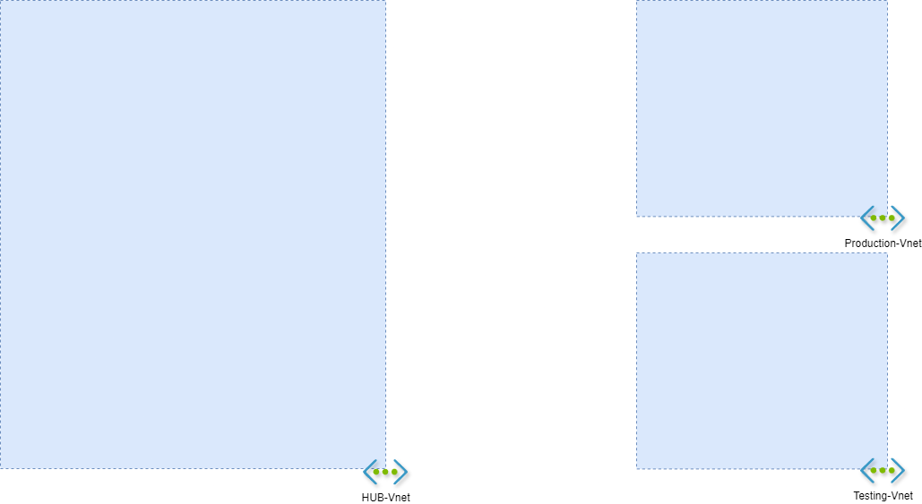
Our Solution:
Created a hub-and-spoke network topology in Azure.
Configured one hub VNet for centralized services and two spoke VNets for hosting both production and testing environments.
01
REQUIREMENT 1: Network Segmentation
The customer requires a cloud design with centralized management and two workload environments: Production and Testing.

Slide 11
Our Solution:
Created a hub-and-spoke network topology in Azure.
Configured one hub VNet for centralized services and two spoke VNets for hosting both production and testing environments.
01
REQUIREMENT 1: Network Segmentation
The customer requires a cloud design with centralized management and two workload environments: Production and Testing.

Slide 12
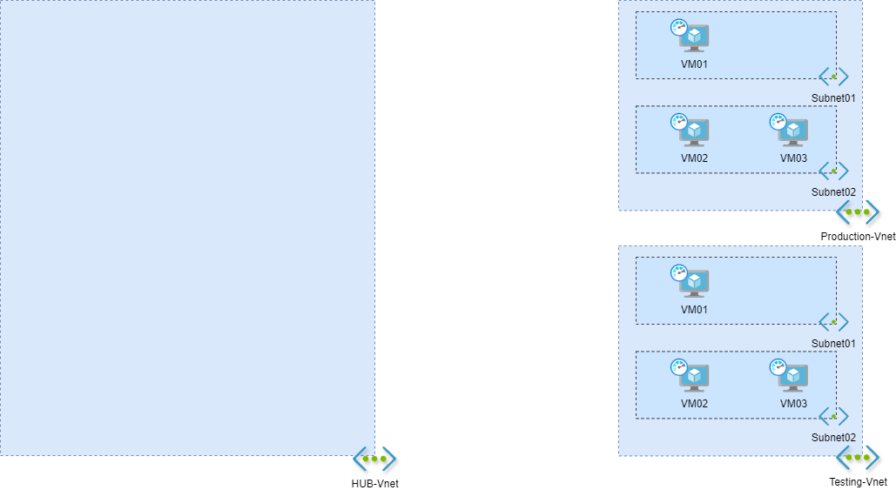
Our Solution:
Chose Virtual Machines for greater control and customization.
Deployed multiple VMs in each spoke VNet to host the web application components, ensuring redundancy and high availability.
02
REQUIREMENT 2: Workload Hosting Service
The customer needs a suitable workload hosting service for his web application with greater control and customization.

Slide 13
Our Solution:
Chose Virtual Machines for greater control and customization.
Deployed multiple VMs in each spoke VNet to host the web application components, ensuring redundancy and high availability.
02
REQUIREMENT 2: Workload Hosting Service
The customer needs a suitable workload hosting service for his web application with greater control and customization.

Slide 14
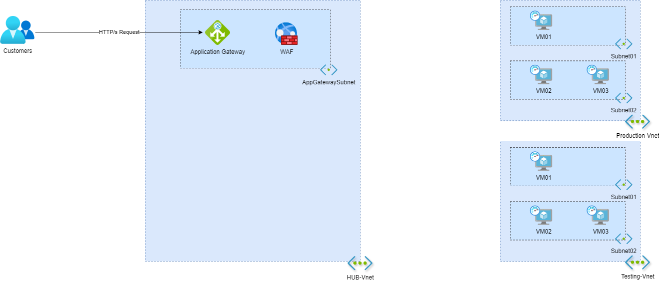
Our Solution:
Configured the Application Gateway for regional, scalable load balancing.
Implemented WAF rules to protect the application from common web vulnerabilities.
03
REQUIREMENT 3: Application Delivery
The customer requires a regional, scalable load balancing option with applicable security rules to ensure secure and reliable delivery of his web application to end users.

Slide 15
Our Solution:
Configured the Application Gateway for regional, scalable load balancing.
Implemented WAF rules to protect the application from common web vulnerabilities.
03
REQUIREMENT 3: Application Delivery
The customer requires a regional, scalable load balancing option with applicable security rules to ensure secure and reliable delivery of his web application to end users.

Slide 16
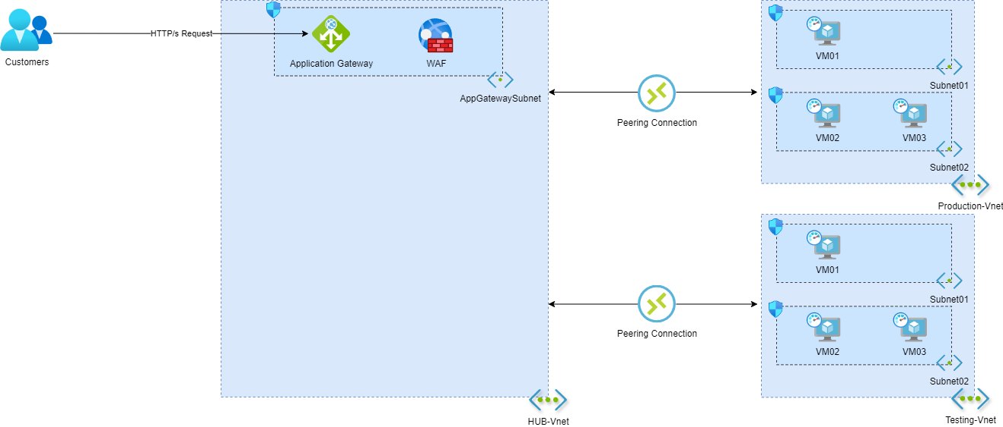
Our Solution:
Established VNet peering between the hub and spoke VNets.
Configured network security groups (NSGs) to control inbound and outbound traffic.
04
REQUIREMENT 4: Secure Connectivity
The customer needs secure and efficient connectivity between the VNets ensuring low latency and high bandwidth communication between the web application components in the spokes and the centralized services in the hub.

Slide 17
Our Solution:
Established VNet peering between the hub and spoke VNets.
Configured network security groups (NSGs) to control inbound and outbound traffic.
04
REQUIREMENT 4: Secure Connectivity
The customer needs secure and efficient connectivity between the VNets ensuring low latency and high bandwidth communication between the web application components in the spokes and the centralized services in the hub.

Slide 18
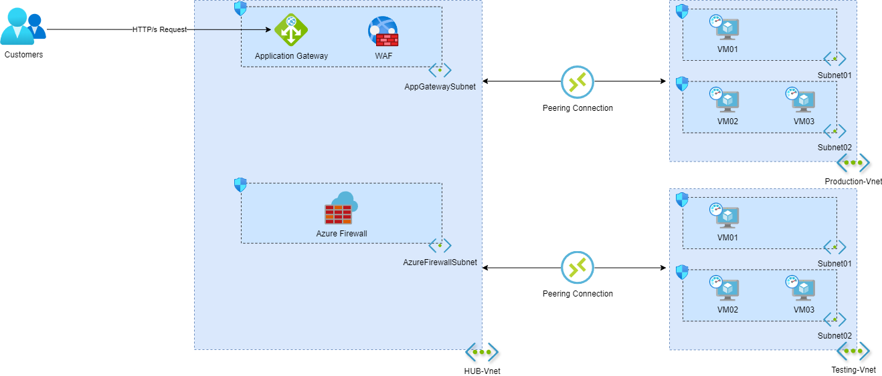
Our Solution:
Deployed an Azure Firewall in the hub VNet.
Configured the firewall to log and control traffic between the hub and spoke VNets.
Implemented security rules to allow only necessary traffic.
05
REQUIREMENT 5: Centralized Firewall
The customer wants a centralized cloud native security service to control and log all network traffic flowing between the VNets, providing an additional layer of security for our web application environment.

Slide 19
Our Solution:
Deployed an Azure Firewall in the hub VNet.
Configured the firewall to log and control traffic between the hub and spoke VNets.
Implemented security rules to allow only necessary traffic.
05
REQUIREMENT 5: Centralized Firewall
The customer wants a centralized network virtual appliance (NVA) solution to control and log all network traffic flowing between the VNets, providing an additional layer of security for our web application environment.

Slide 20
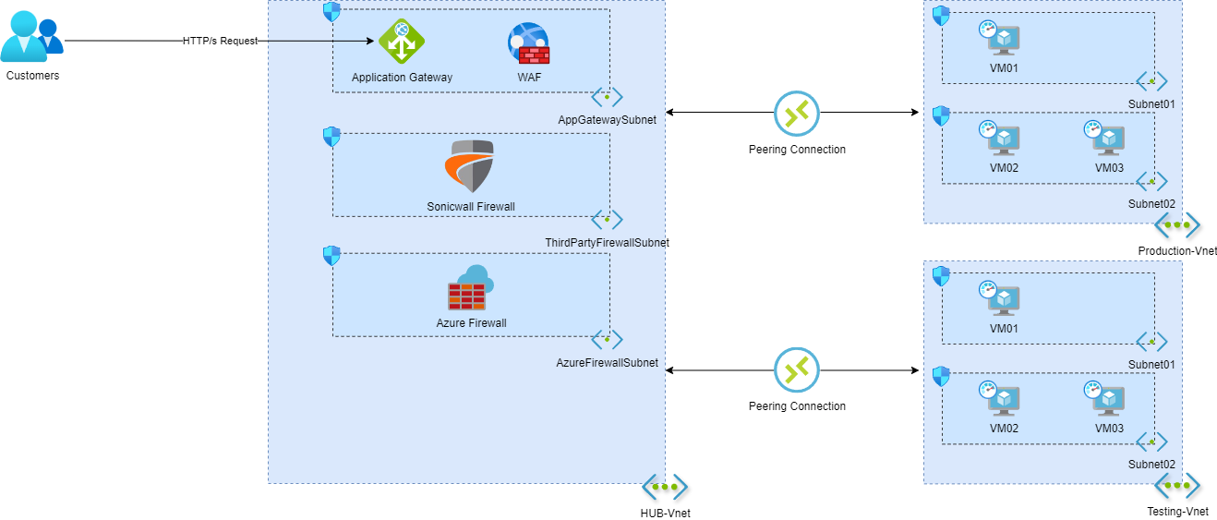
Our Solution:
Deployed a third-party firewall in the hub VNet.
Configured the third-party firewall to work alongside Azure Firewall for enhanced security.
06
REQUIREMENT 6: Third-Party NVA
Because of additional security appliances, the customer requires the implementation of a third-party firewall in the hub VNet to provide additional security measures and advanced threat protection for his infrastructure.

Slide 21
Our Solution:
Deployed a third-party firewall in the hub VNet.
Configured the third-party firewall to work alongside Azure Firewall for enhanced security.
06
REQUIREMENT 6: Third-Party NVA
Because of additional security appliances, the customer requires the implementation of a third-party firewall in the hub VNet to provide additional security measures and advanced threat protection for his infrastructure.

Slide 22
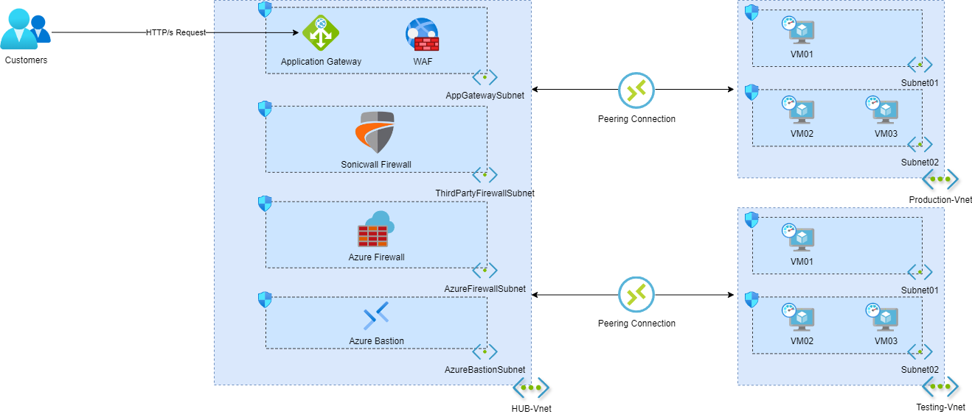
Our Solution:
Set up an Azure Bastion host in the hub VNet.
Configured Bastion for secure RDP/SSH connectivity to VMs in the spoke VNets.
Eliminated the need to expose VMs to the public internet, ensuring secure access.
07
REQUIREMENT 7: Secure Remote Access
To facilitate management and maintenance, the customer needs a secure solution for RDP/SSH connectivity to the virtual machines hosting his web application components without exposing them to the public internet.

Slide 23
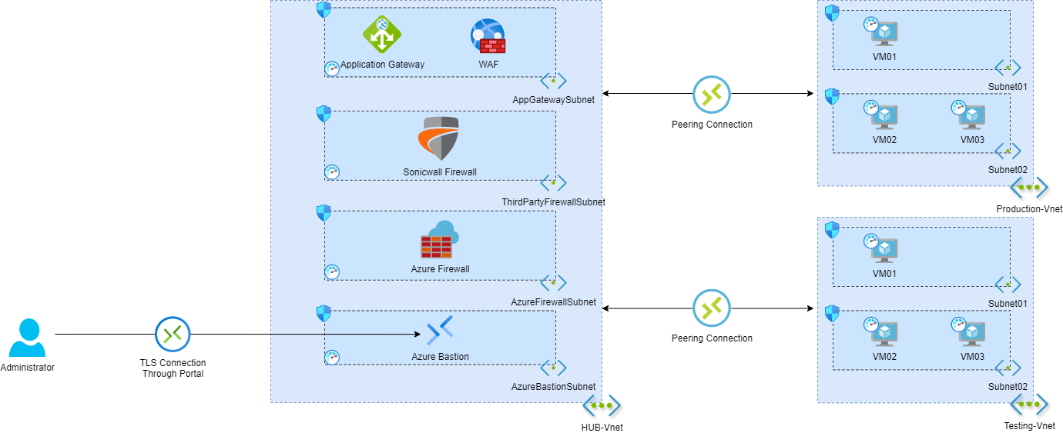
Our Solution:
Set up an Azure Bastion host in the hub VNet.
Configured Bastion for secure RDP/SSH connectivity to VMs in the spoke VNets.
Eliminated the need to expose VMs to the public internet, ensuring secure access.
07
REQUIREMENT 7: Secure Remote Access
To facilitate management and maintenance, the customer needs a secure solution for RDP/SSH connectivity to the virtual machines hosting our web application components without exposing them to the public internet.

Slide 24
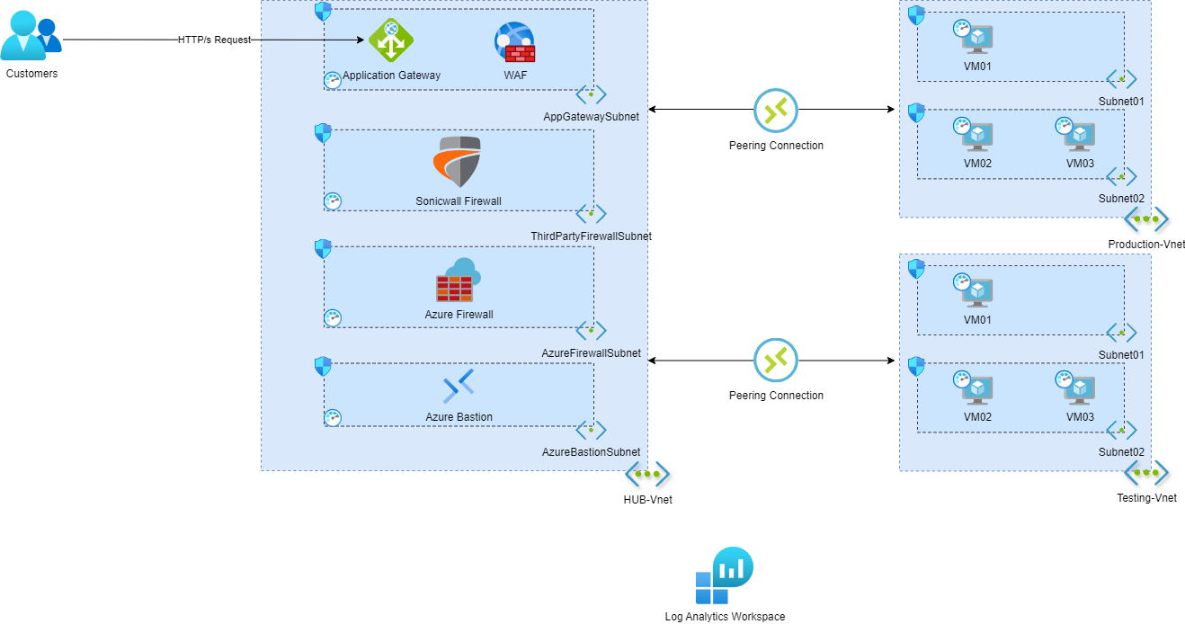
Our Solution:
Integrated Azure Monitor and Log Analytics Workspace.
Configured monitoring and logging for all components of the infrastructure.
Set up alerts and dashboards to proactively manage and troubleshoot the environment.
08
REQUIREMENT 8: Monitoring and Logging
The customer needs comprehensive monitoring and logging capabilities to collect and analyze logs and metrics from all components of our web application environment for effective monitoring and troubleshooting.

Slide 25
Our Solution:
Integrated Azure Monitor and Log Analytics Workspace.
Configured monitoring and logging for all components of the infrastructure.
Set up alerts and dashboards to proactively manage and troubleshoot the environment.
08
REQUIREMENT 8: Monitoring and Logging
The customer needs comprehensive monitoring and logging capabilities to collect and analyze logs and metrics from all components of our web application environment for effective monitoring and troubleshooting.

Slide 26
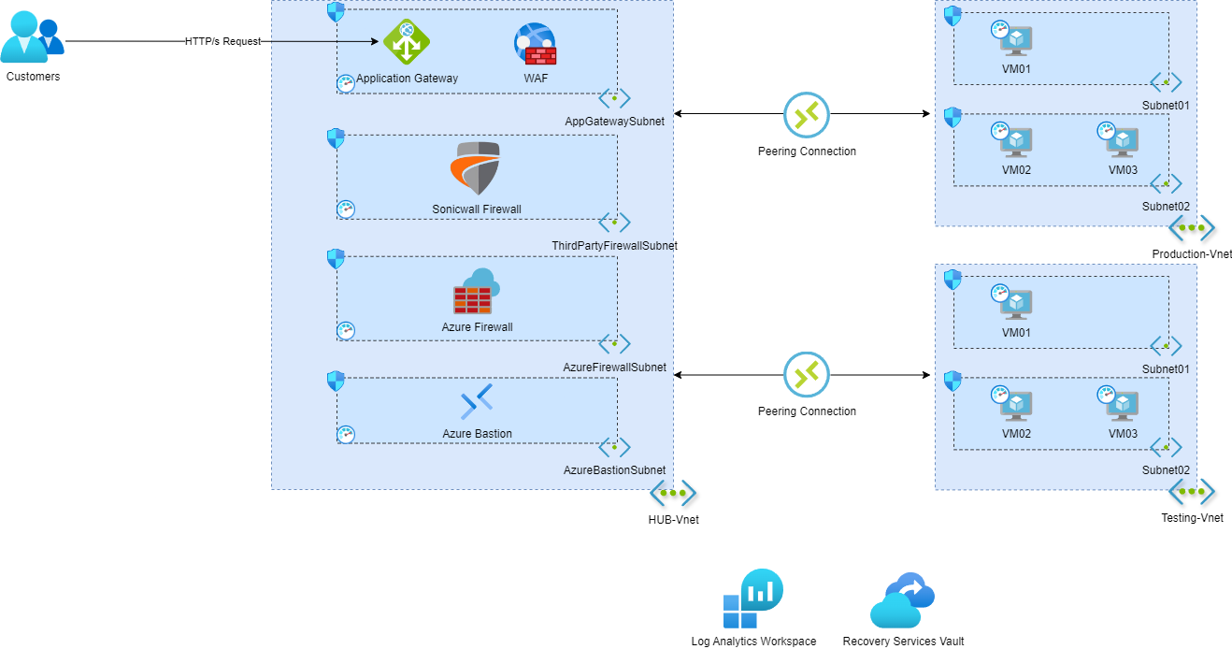
Our Solution:
Implemented Azure Backup and Recovery Services Vault.
Configured regular backups for all VMs hosting the web application components.
09
REQUIREMENT 9: Backup and Disaster Recovery
The customer wants regular backups and quick recovery of the virtual machines hosting his web application components to protect against data loss and ensure business continuity.

Slide 27
Our Solution:
Implemented Azure Backup and Recovery Services Vault.
Configured regular backups for all VMs hosting the web application components.
09
REQUIREMENT 9: Backup and Disaster Recovery
The customer wants ensure regular backups and quick recovery of the virtual machines hosting his web application components to protect against data loss and ensure business continuity.

Slide 28
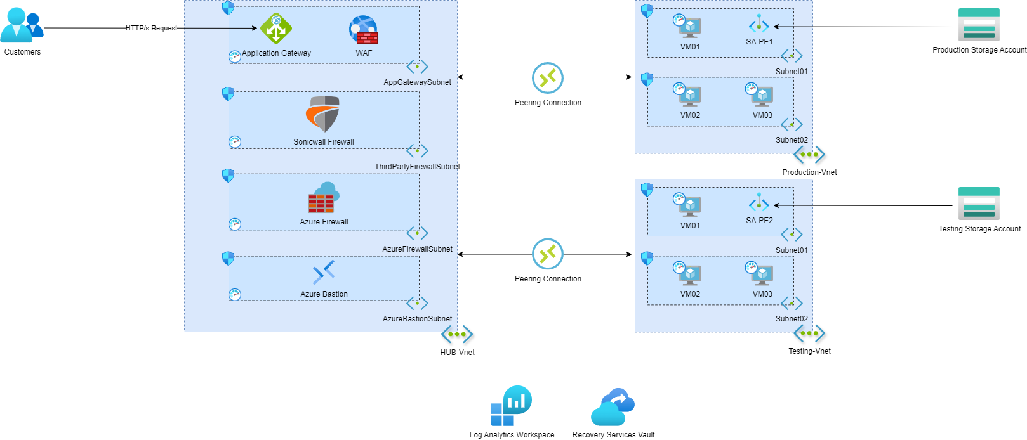
Our Solution:
Created a storage account with private endpoints.
Connected the private endpoints to each VM subnet in the spoke VNets.
Enabled secure access to the storage account, preventing exposure to the public internet.
10
REQUIREMENT 10: Secure Storage Access
The customer requires a secure solution for his virtual machines to access a shared storage for storing application data without exposing it to the public internet.

Slide 29
Our Solution:
Created a storage account with private endpoints.
Connected the private endpoints to each VM subnet in the spoke VNets.
Enabled secure access to the storage account, preventing exposure to the public internet.
10
REQUIREMENT 10: Secure Storage Access
The customer requires a secure solution for his virtual machines to access a shared storage for storing application data without exposing it to the public internet.

Slide 30
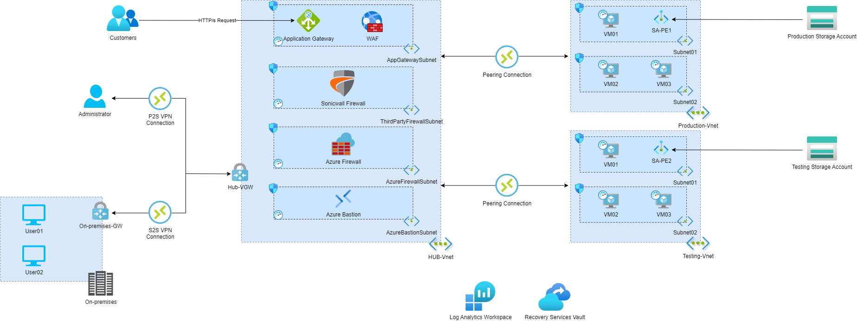
Our Solution:
Implemented a VPN Gateway to establish a secure connection between the on-premises network and Azure.
Configured a site-to-site (S2S) VPN to enable secure and seamless access for on-premises users.
Created a point-to-site (P2S) VPN for individual users to securely connect to the Azure infrastructure from remote locations
11
REQUIREMENT 11: On-Premises Connectivity
The customer wants a secure solution to connect his on-premises users to our Azure infrastructure, ensuring seamless and secure access to his web application and resources hosted in the cloud.

Slide 31
Our Solution:
Implemented a VPN Gateway to establish a secure connection between the on-premises network and Azure.
Configured a site-to-site (S2S) VPN to enable secure and seamless access for on-premises users.
Created a point-to-site (P2S) VPN for individual users to securely connect to the Azure infrastructure from remote locations
11
REQUIREMENT 11: On-Premises Connectivity
The customer wants a secure solution to connect his on-premises users to our Azure infrastructure, ensuring seamless and secure access to his web application and resources hosted in the cloud.

Slide 32
The Final Architecture

Slide 33
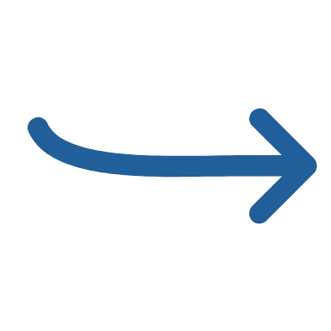
Traffic Directions

Slide 34
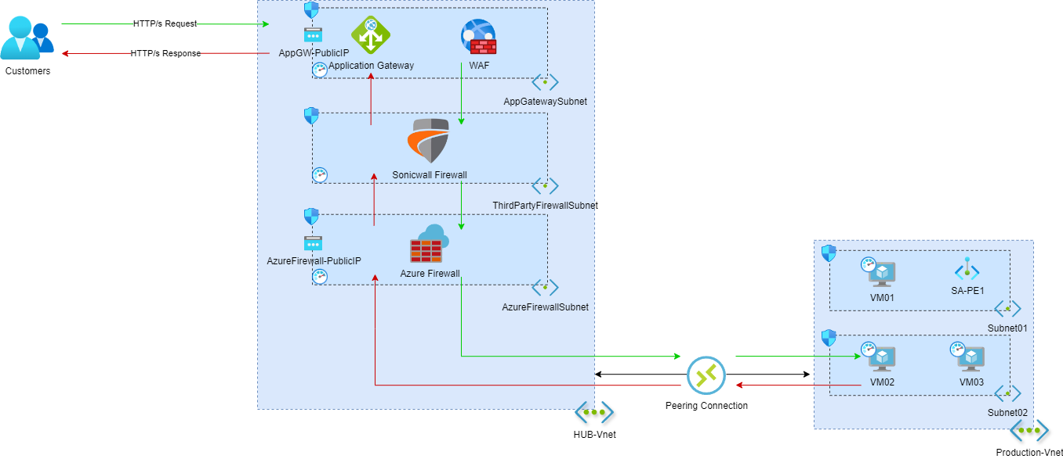
HTTP/s Traffic from Public Internet

Slide 35
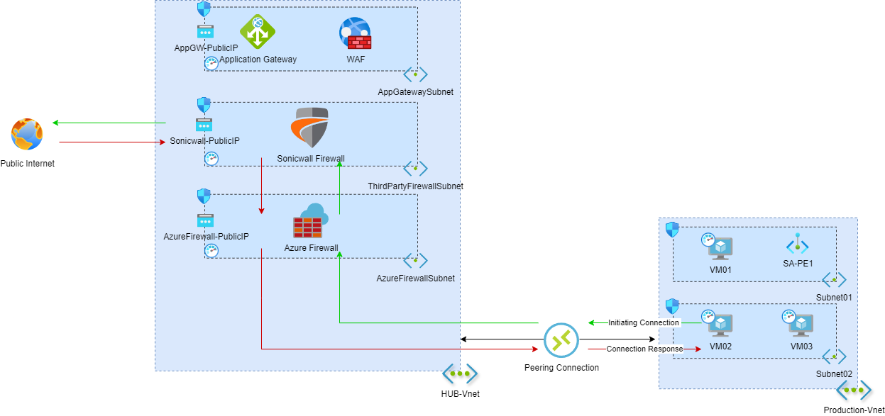
Outbound Traffic to Public Internet

Slide 36
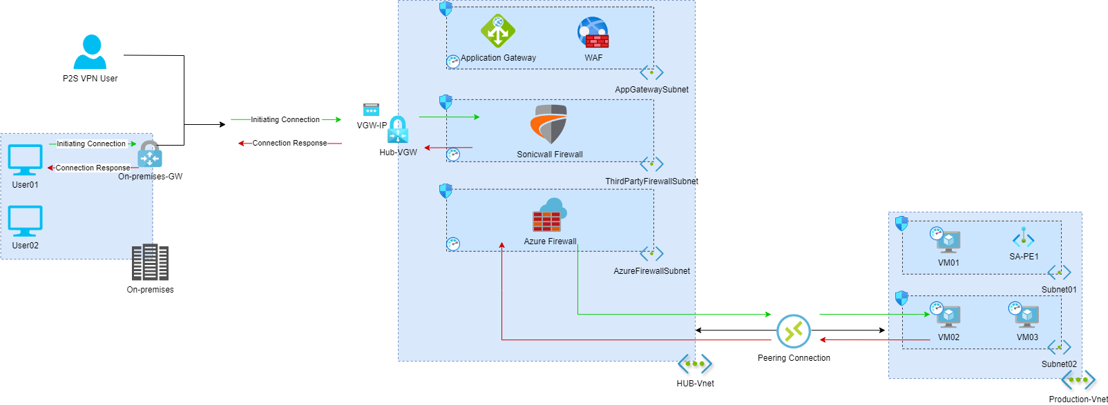
VPN User Traffic inside Network

Slide 37
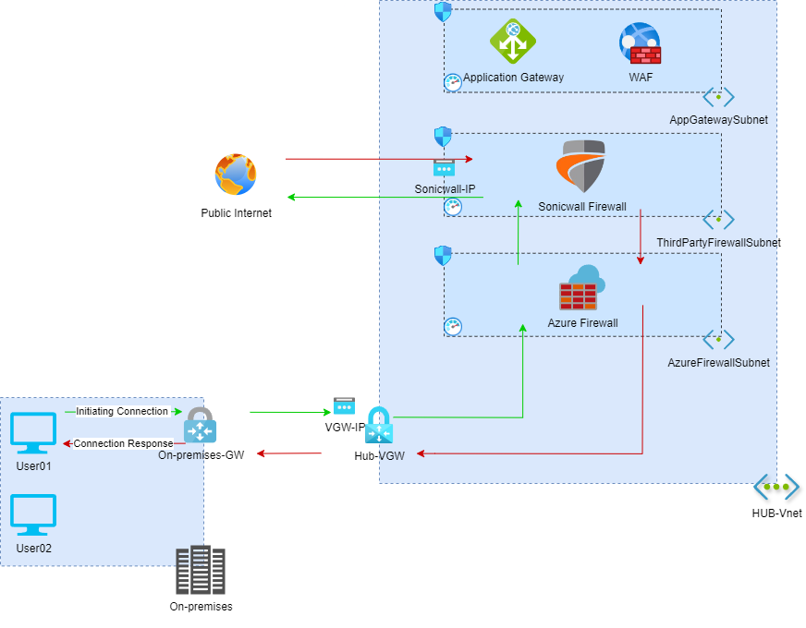
On-Premises User Traffic to Public Internet

Slide 38
Demo

Slide 39

Any Questions

Slide 40

Thanks

